Slide 1
Nursing Theorist Group Presentation
IMOGENE KING
Interacting and Open Systems Model, and Attainment Goal Theory
Kelly Jones, Mandi Kucharek,
Kelly Snyder, Cheryl Veres

Slide 2
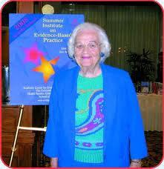
Introduction
Imogene King
Born on January 30, 1923 inWest Point, Iowa
1945 Received nursing diploma from St. John's Hospital School of Nursing in St.Louis Missouri
1948 Received her BSN in nursing education from St. Louis University
1957 Acquired Master's of Science in Nursing also from St. Louis University
1961 Earned Doctoral of education degree from Teacher's College, Columbia University in New York City.
1966-1968 Spent in the academic settings of Ohio State, University, Loyola University, and the University of South Florida.
Died on December 24, 2007
(http://currentnursing.com/nursing_theory/goal_attainment_theory.html)
(Chitty and Black, 2011)

Slide 3
A nursing theory is a statement of linked concepts that explain, predict, control, and understand the occurring phenomena that interests nurses........
the conceptual models or frameworks are the conceptual structures that define those concepts, and are used as tools to integrate and interpret the information.
(Chitty and Black, 2011)

Slide 4
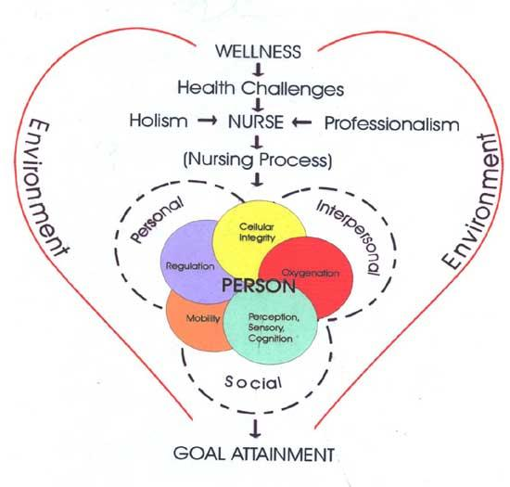
King's Attainment Goal Theory
(http://www.palmbeachstate.edu/x3194.xml)
Assumption is that the patient and nurse communicate, participate in mutual goal setting, and take actions to achieve those goals together.
(http://currentnursing.com/nursing_theory/goal_attainment_theory.html) (Williams, L. A., 2001)

Slide 5
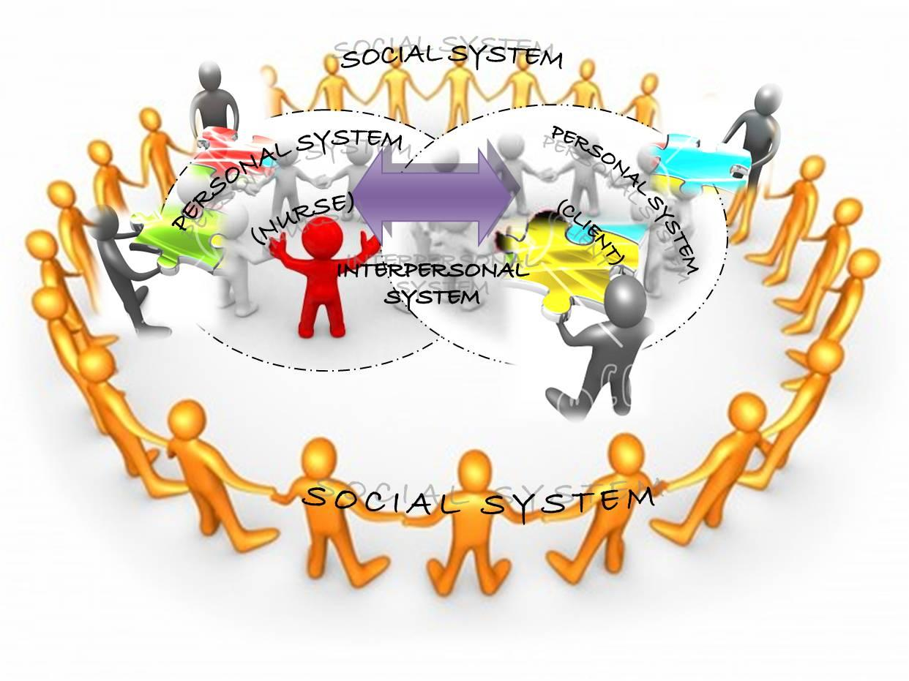
King's Interacting and Open Systems Model
(http://nursingtheories.blogspot.com/2009/07/queen-who-is-king.htmltp:)
Assumption is that the focus is on the person and the three interacting systems: personal, interpersonal, and social, within their interpersonal relationships and social contexts.
(http://currentnursing.com/nursing_theory/goal_attainment_theory.html) (Williams, L. A., 2001)

Slide 6
According to King
A Human Being...
Refers to social beings that are rational and sentient
The focus of nursing care
Are open systems constantly interacting with their environment
Consists of three systems which include
Individual~Personal System
Groups~Interpersonal System
Society~Social System
Have the ability to perceive, think, feel, choose, set goals, select ways to achieve goals, and make decisions
Requires three basic needs
The need for health information that can be used when needed
The need for care to prevent illness
The need for care when a person is unable to help themselves
(http://nursingbuddy.com/2011/02/25/imogene-king)
(http://currentnursing.com/nursing_theory/goal_attainment_theory.html)

Slide 7
According to King
The Environment...
Is consistently changing
Is the background for human interaction
Involves two types of environment
Internal Environment: Transforms energy to allow the person to adjust to the continuous external environment changes
External Environment: Includes formal and informal organizations with the nurse being part of the patient's environment
(http://currentnursing.com/nursing_theory/goal_attainment_theory.html)
(http://nursingbuddy.com/2011/02/25/imogene-king)

Slide 8
HEALTH
According to Imogene King, health involves dynamic life experiences of a human being, which implies continuous adjustment to stressors in the internal and external environment through optimum use of one's resource to acheive maximum potential for daily living.
(http://nursingtheories.info/nursing-theory-by--imogene-king-goal-attainment-theory/)

Slide 9
NURSING
"Nursing for Imogene King is an act wherein the nurse interacts and communicates with the patient. The nurse helps the patient identify the existing health condition, exploring and agreeing on activities to promote health. The goal of the nurse in Imogene King's theory is to help the patient maintain health through health promotion and maintenance, restoration, and caring for the sick and dying."
http://nursingtheories.info/nursing-theory-by-imogene-king-goal-attainment-theory/)

Slide 10
Nursing continued:
Definition: "A process of action, reaction, and interaction by which nurse and patient share information about their preception in the nursing situation." and "a process of human interaction between nurse and patient whereby each perceives the other and the situation, and through communication, they set goals, explore means, and agree on means to achieve goals."
Action: is defined as a sequence of behaviors involving mental and physical action
Reaction: which is considered as included in the sequence of behaviors described in action.
In addition, King discussed:
(a) goal
(b) domain and
(c) functions of professional nurse
(http://currentnursing.com/nursing_theory/goal_attainment_theory.html)

Slide 11
Imogene King's Theory of goal attainment was first introduced in the 1960's.
( http://nursing-theory.org/nursing-theorist/Imogene-King.php)

Slide 12
Concept of Goal Attainment Thoery
The nurse and patient communicate information, set goals together, and then take action to achieve those goals.
An interpersonal relationship that allows a person to grow and develop in order to attain certain life goals.
Factors that affect the attainment of goals
Roles
Stress
Space
Time
http://nursing-theory.org/nursing-theorists/Imogene-King.php

Slide 13
Concepts for personal systems
Personal system
perception, self growth and development, body image, space, and time.
Interpersonal system
interaction, communication, transaction, role, and stress.
Social system
organization, authority, power, status, and decision making.
http://nursing-theory.org/theories-and-models/king-theory-of-goal-attainment.php

Slide 14
Concepts cont...
Personal- If perceptual interaction accuracy is present in nurse-patient interactions, transaction will occur.
If the nurse and patient make transaction, the goal or goals will be achieved.
If the goal or goals are achieved, satisfaction will occur.
Personal- If role expectations and role performance as perceived by the nurse and patient, growth and development will be enhanced.
Interpersonal- If role conflict is experienced by ether the nurse or the patient (or both), stress in the nurse-patient interaction will occur.
If a nurse with special knowledge communicates appropriate information to the patient, mutual goal-setting and goal achievement will occur.
(http://nursing-theory.org/theories-and-models/king-theory-of-goal-attainment.php)

Slide 15
According to King...
The patient is a social being who has three fundamental needs:
the need for health information
the need for care that seeks to prevent illness
the need for care when the patient is unable to help him or herself
Also health is involving life experiences of the patient, which includes adjusting to stressors in the internal and external environment by using resources available.
http://nursing-theory.org/nursing-theorists/Imogene-King.php

Slide 16
Can The Theory of Goal Attainment be implemented in the emergency department?
A busy emergency department often creates an intimidating environment for patients and they may feel threatened, or feel that they have no control over decisions that affect their care.
The primary complaint of emergency room patients is the length of waiting time. Waiting two hours may seem like an eternity for the patient, but for the nurse, time passes swiftly.
In an environment that requires one to be reactive and responsive, clients often perceive the nurses as being too busy or too hurried (Williams, 2001).

Slide 17
﻿What can the nurse in
the emergency department
do for the patient using King's Theory of Goal Attainment.
Remember that: "An individual's perceptions of self, of body image, of time and space influence the way he or she responds to persons, objects, and events in his or her life span, experiences with changes in structure and function of their bodies over time influence their perceptions of self" (King, 1981),(Williams, 2001).
King used ten major concepts from the personal and interpersonal system to support the Theory of Goal Attainment:
Human interactions and perception- clients often perceive nurses as being too busy or hurries, nurses need to be aware of how they present themselves to their clients.
Communication- Poor communication skills lead to poor transactions and interactions between the nurse and client. Poor communication skills also affect goal setting and goal attainment. Good communication skills are crucial.
Role- The nurse needs to know their role to help the patient through their encounter, and help them attain their health goals.
Stress- An emergency room can be a stressful place for the patient and family. Providing appropriated care, proper communication skills, and decreasing stress in every was possible.

Slide 18
Continued....
Time- In the emergency department, the patient's complain of a long wait time. Interventions that have proven to be successful in this situation, is placing telephones and televisions in the patient rooms. This seems to pass the time and relieve frustration.
Space-
Growth and Development
These points fit into the concepts of the theory personal, interpersonal, and social.
Personal being the time that the patient feels they are waiting, and the interventions that can be done to help reduce the wait time.
Interpersonal being the good or poor communication skills between the patient and the nurse. It can also be the stress that the patient feels when they are in the emergency department, and what the nurse does to relieve that stress.
Social is the decision making that the nurse makes to get the patient to their goal. The patient comes into the emergency department with complaints of difficulty breathing. There can be several outcomes. Does the nurse listen to the patient, the family, what decisions are made to get to the goal.
(Williams,2001) http://nursing-theory.org/theories-and-models/king-theory-of-goal-attainment.php

Slide 19
Clarification of Origins...
"King's philosophy is unique because it provides a view of persons from the perspective of their interactions (or communications, both verbal and nonbverbal) with other people at three levels of interacting systems."
"The theory of goal attainment was derived from King's conceptual system."
(Messmer, 2006)
(Chitty, K.K. & Black, B.P.)

Slide 20
Goal Attainment theory can be used in any setting. Nurses should always be in communication with the patient to reach the goal of health.
Narrow View
"Several individuals have developed theories from King's conceptual system along with instruments to measure the concepts. Nurses have published multiple examples of the usefulness of the conceptual systems and theory of goal attainment in practice."
"The concepts of Goal Attainment are very specific. The nurse and patient must communicate, set goals together, and take action to acheive the goals."
(Messmer, 2006)

Slide 21
What practice situations can/has this model been used in? Here are two examples...
Theory of Goal Attainment has been used in numerous practice situations. According to Messmer, "the neonatal intensive care unit (NICU) used this theory to transform their practice. The nurses in the NICU feel that parents believe the NICU prevents them from assuming a parental role. When the nurses and parents work together to set goals it helps the parents function in the parental role."
"Knowledge of concepts of health, self, role, perception, transaction, stress, and power in transforming practice with five elderly women in a nursing home. The nurse made a diagnosis and mutually set goals with the women then described her actions in helping them acheive their goals. The application of knowledge of the concepts in King's theory attests to its value in caring for the residents in a nursing home."
(Messmer, 2006)

Slide 22
So What can we Conclude??
Nurse-client interactions increase mutual goal setting
Open communication increases the likelihood of nurse-client goal setting and satisfaction
Nurse-client satisfaction increases goal attainment
Reaching goal attainment decreases stress and anxiety and increases client learning and the ability to cope in nursing situations
Nurse-client role and conflict results in decreased interactions
Nurse-client agreement in role expectations and performance increases meaningful nurse-client interactions
(http://nursingbuddy.com/2011/02/25/imogene-king)

Slide 23
Case Study
A 23 year old pregnant female, 39 weeks, gravida 1 para 0 arrives on the Obstetrics Unit with her significant other complaining of "frequent contractions". Upon examination the nurse determines the patient is in labor. Vital signs are stable and orders have been obtained from the physician. After having the patient change into a gown, the nurse then begins to hook the patient to the monitor. As she is attaching the monitor, she explains the purpose of the monitor and what the patient should expect such as frequent blood pressures. The nurse than begins her admission assessment. During the assessment the nurse explains the different stages of labor and what to expect during those stages. They discuss the patients and her significant others birthing plan. Expectations between the nurse, the patient and her significant other are discussed. They all agree on a plan of care.

Slide 24
Case Study Cont.
Based on the information given, which of King's interacting systems are utilized? Is there more than one used? Please explain your answer. You can refer to the "Human Being" slide for assistance.

Slide 25
APA Format for References
TEXT
Chitty, K.K., & Black, B.P. (2011). Professional nursing: Concepts and challenges (6th ed.) Maryland Heights, MO: Saunders.
Current Nursing. (2012). Nursing theories: Imogene King's theory of goal attainment. Retrieved from http://currentnursing.com/nursing_theory/goal_attainment_theory.html
Nursing Science Quarterly 1997 King's Theory of Goal Attainment in Practice.
King's Theory of Goal Attainment in Practice (1997). Nursing Science Quarterly, 10(180), 180-185, doi: 10.1177/089431849701000411.
Manayan and Manlapaz (2009) Manayan M C Manlapaz K K 20090716 Nursing Theories: the Queen Who is KingManayan, M. C., & Manlapaz, K. K. (2009, July 16). Nursing Theories: the Queen Who is King. Retrieved from http://nursingtheories.blogspot.com/2009/07/queen-who-is-king.html
Messmer P R 2006 Professional Model of Care: Using King's Theory of Goal Attainment.
Messmer, P. R. (2006). Professional Model of Care: Using King's Theory of Goal Attainment. Nursing Science Quarterly, 19(227), 227-229, doi: 10.1177/0894318406289887.
NursingBuddy: Online Nursing Resource (2011, February 25) NursingBuddy: Online Nursing Resource 20110225NursingBuddy: Online Nursing Resource (2011, February 25). Retrieved from http://nursingbuddy.com/2011/02/25/imogene-king

Slide 26
References cont.
Williams, L. A. (2001). Imogene King’s interacting systems theory: Application in emergency and rural nursing. Online Journal of Rural Nursing and Health Care, (2)1, 25, 26. Retrieved from http://www.rno.org/journal/index.php/online-journal/article/viewFile/93/89
Imogene King. (2011) Nursing Theory. Retrieved from http://nursing-theory.org/nursing-theorist/Imogene-King.php
King's Theory of Goal Attainment. (2011) Nursing Theory. Retrieved from http://nursing-theory.org/theories-and-models/king-theory-of-goal-attainment.php
IMAGES
Palm Beach State College. Goal attainment. Retrieved, 2012, from
http://www.palmbeachstate.edu/x3194.xml
UPOU N207 Students. (2008). Blog archive: Reflections from the past and a vision for the future: King's theory and its application. Retrieved from http://imogene-king.blogspot.com/
UPOU N207 Students. (2009). Blog archive: The queen who is king: Imogene King: The queen of goal attainment theory. Retrieved from http://nursingtheories.blogspot.com/2009/07/queen-who-is-king.html

